Slide 1

Pokémon Team Builder
Harry Cope

Slide 2
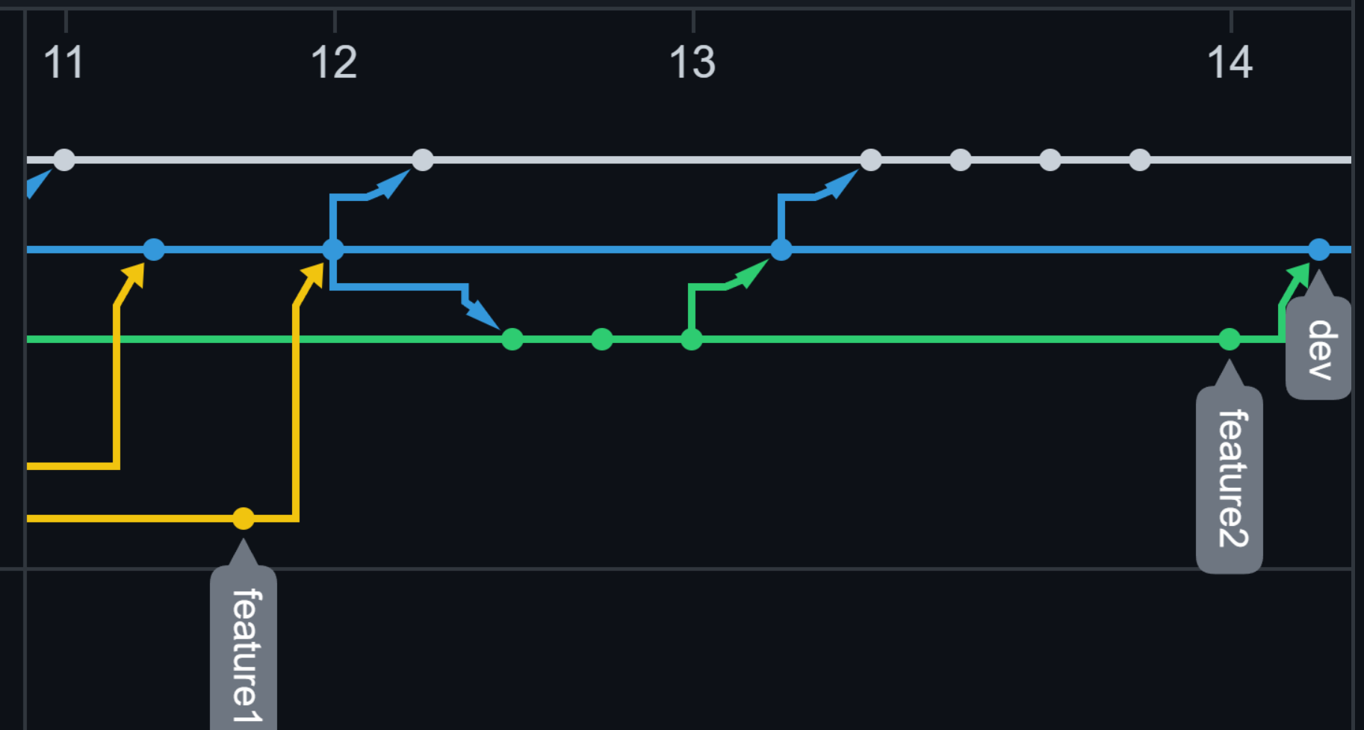
Introduction
Risk assessment
Set up my schema
Git hub repo
Master
Dev
Feature Branches

Slide 3
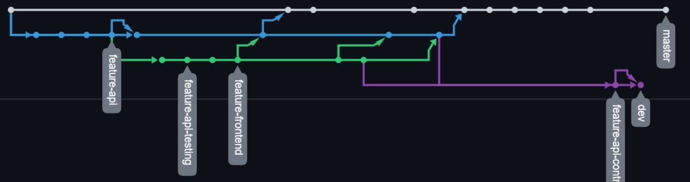
Version control
Created Feature branches for any major changed
Each day the current feature branch was merged to dev

Slide 4
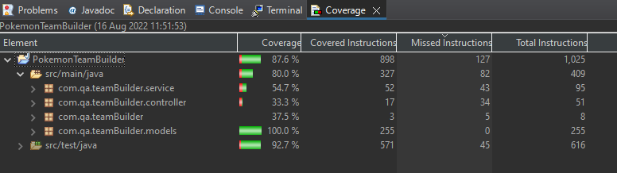
Testing
Achieved 80% coverage
Some of the controllers remain untested due to errors and time constraints.

Slide 5
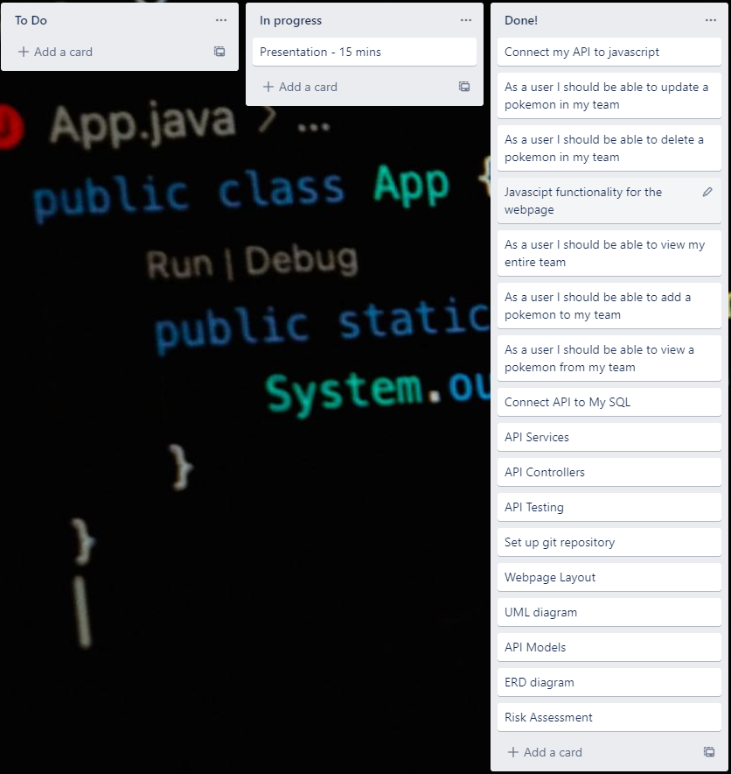
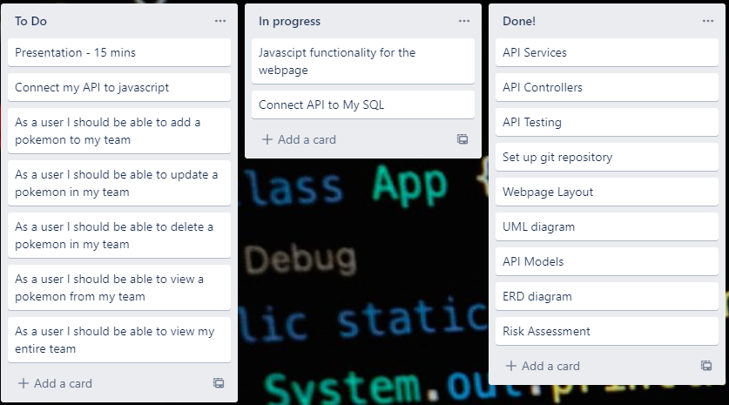
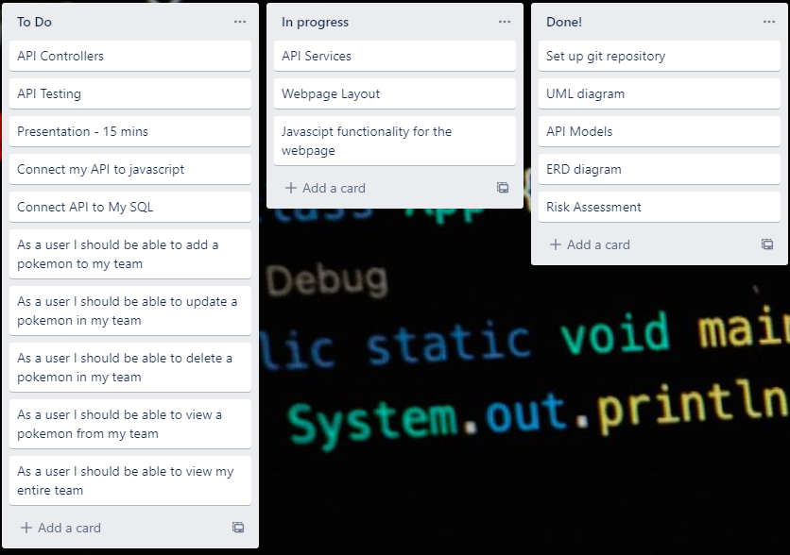
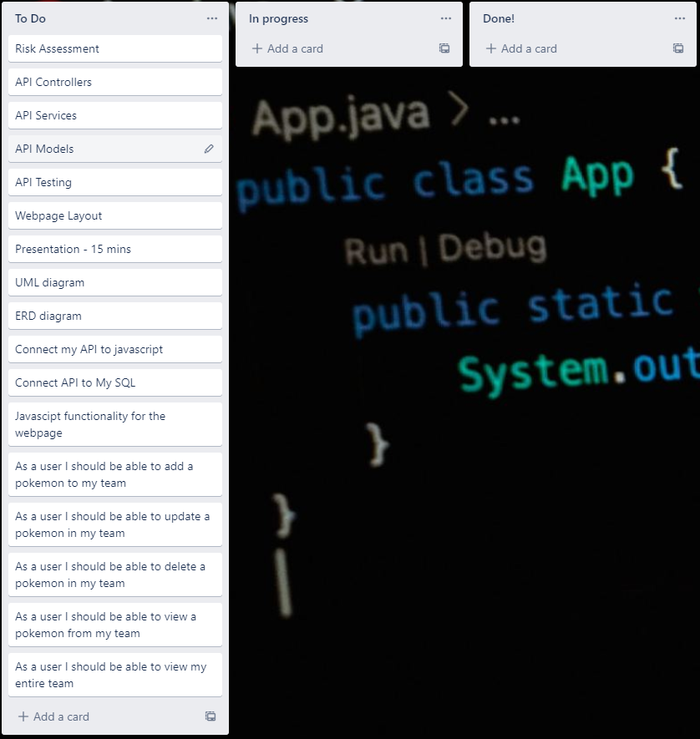
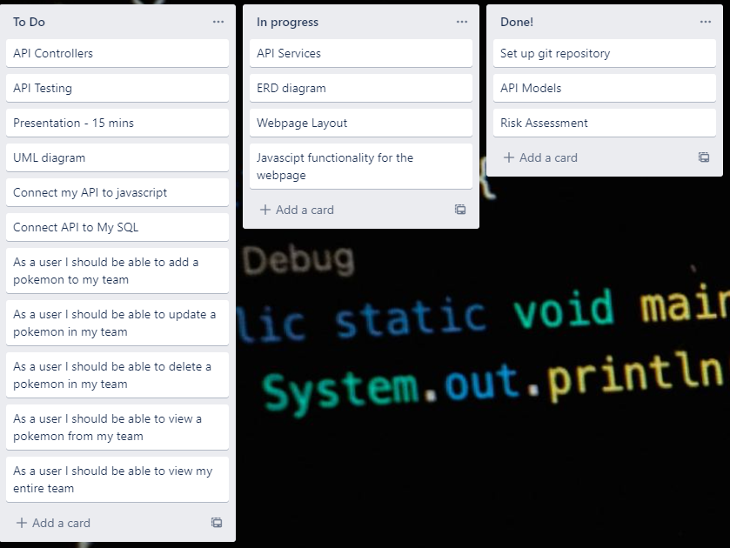
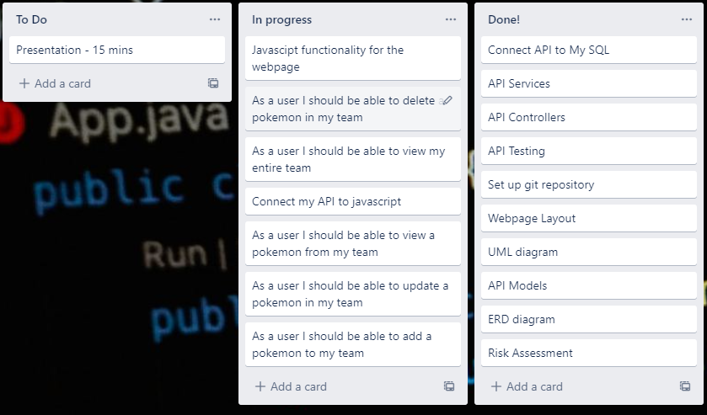
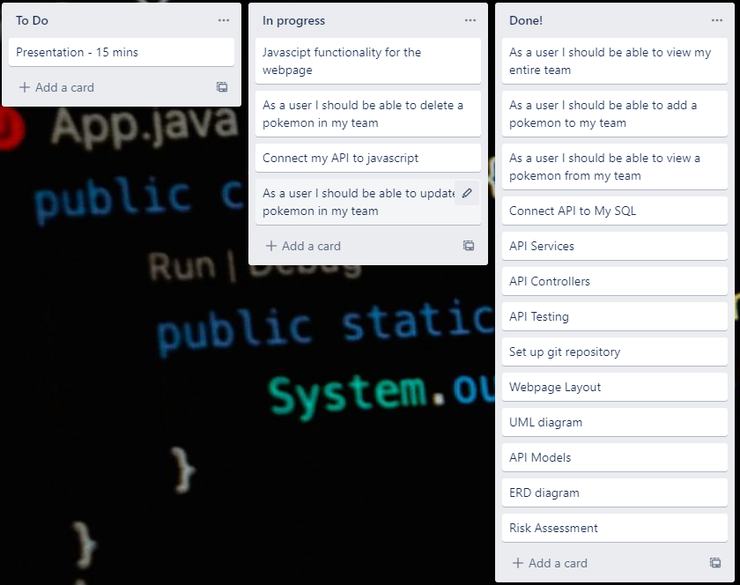
Sprint review

Slide 6
Code Demo

Slide 7
Sprint retrospective and Conclusions
Creating the tests for the Pokémon and team class made it easier to plan ahead.
Errors joining the front end to my API.
Could have made more improvements to the look of the webpage maybe adding some other features.

